Slide 1

Predicting the Higgs-Boson signal
- A kaggle challenge
Diego De Lazzari | Linlin Cheng | Danli Zeng

Slide 2
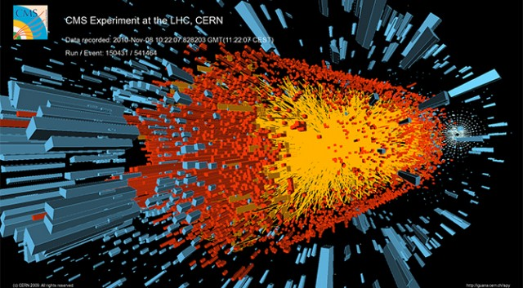
introduction
The Higgs boson was the last hold-out particle remaining hidden during the quest to check the accuracy of the Standard Model of Physics.
On March 14, 2013 CERN officially announced the confirmation of the Higgs boson.
This Kaggle competition is about trying to filter out signal from background noise using selected & simulated ATLAS experiment data.

Slide 3
EDA AGGR MISSINGNESS
7 variables always missing
together
3 variables are missing only
when the other 7 variables
are missing
1 variable can be missing on
Its own

Slide 4
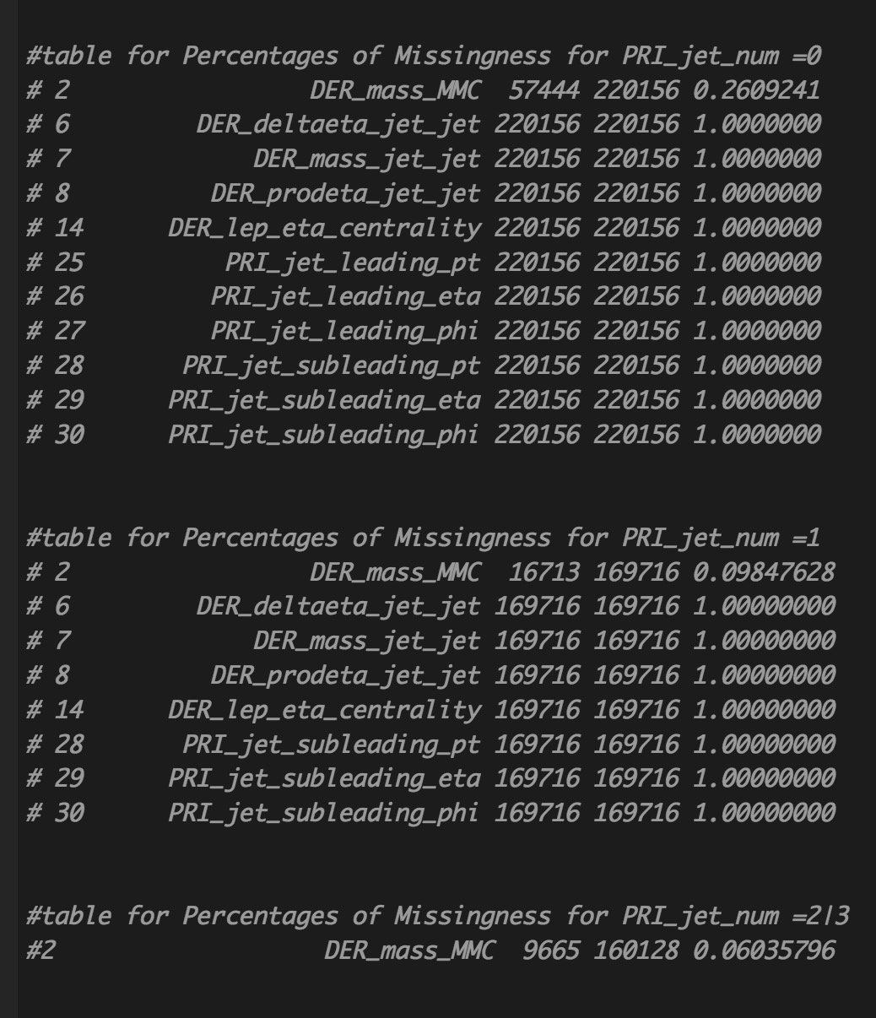
MISSINGNESS & PRI_jet_num
"DER_deltaeta_jet_jet"
"DER_mass_jet_jet"
"DER_prodeta_jet_jet"
"DER_lep_eta_centrality"
"PRI_jet_subleading_pt"
"PRI_jet_subleading_eta"
"PRI_jet_subleading_phi"
Gang of 7: 71% missing and always be missing together
"PRI_jet_leading_pt"
"PRI_jet_leading_eta"
"PRI_jet_leading_phi"
Gang of 3: 40% missing and always be missing together, only missing when gang of 7 are missing
"DER_mass_MMC":
15% missing and can be missing on its own

Slide 5
Random Forest
FEATURE
IMPORTANCE
If there were no missing
value, which features are
The most important ones?

Slide 6
PCA
SCREE plot
Took and applied
11 PCs

Slide 7
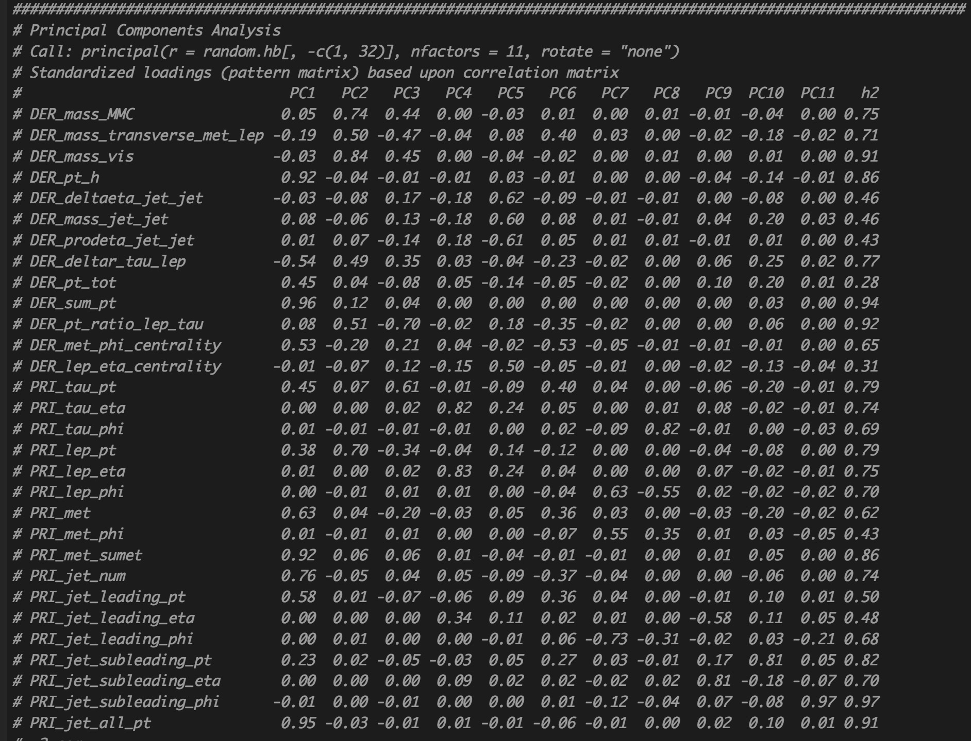
PCA
0.69 Cumulative Variance
Explained by 11 PCs, not
good enough for using
PCs to train model
All the variables are at least
Contributing to one of the
PCs
We can not dump variables
frivolously

Slide 8
EDA DATA DISTRIBUTION
Deleted a couple of
observations containing
extreme outliers

Slide 9
EDA correlation
Some variables seem
to be correlated, however,
considering many DER vars
are derived from the PRI vars,
some correlation seems to be
acceptable

Slide 10
Work Flow
Raw Data
Subset by “PRI_jet_num”
0 1 2 & 3
Apply to Test Dataset:
Break test into: test_0 | test_1 | test_23
Plug into 3 ensemble models
Stack results into 1 submission file
Drop:
DER_deltaeta_jet_jet DER_mass_jet_jet DER_prodeta_jet_jet DER_lep_eta_centrality PRI_jet_leading_pt PRI_jet_leading_eta PRI_jet_leading_phi PRI_jet_subleading_pt PRI_jet_subleading_eta PRI_jet_subleading_phi
PRI_jet_num
PRI_jet_all_pt
DER_lep_eta_centrality DER_deltaeta_jet_jet DER_mass_jet_jet DER_prodeta_jet_jet PRI_jet_subleading_pt PRI_jet_subleading_eta PRI_jet_subleading_phi
None
Impute:
DER_mass_MMC
(0.26 missing)
DER_mass_MMC
(0.1 missing)
DER_mass_MMC
(0.061 missing)
Tune threshold respectively for
3 ensemble models
Tune
XGB
RF
Ada
For df0
Tune
XGB
RF
Ada
For df1
Tune
XGB
RF
Ada
For df23
Caret Stack
(using gbm):
ensemble_df0
ensemble_df1
ensemble_df23
Apply
Parameters
Caret_List
For df0
Apply
Parameters
Caret_List
For df1
Apply
Parameters
Caret_List
For df23

Slide 11
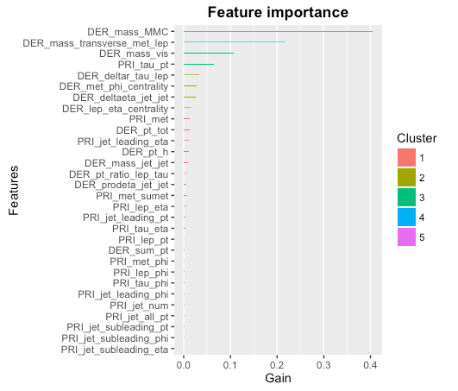
Tuning Parameters – XGBoost
Metric: AMS
Best Parameters for XGB:
eta=0.03,
max_depth=c(10),
nrounds=800,
gamma = .1,

Slide 12
Tuning Parameters - RF
Metric: ROC
 | DF_0 | DF_1 | DF_23
Best mtry | 2 | 8 | 8
Test Error | # pred_rf_df0 0 1 # X0 13963 1987 # X1 963 3069 # Error Rate: [1] 0.1476329 | # pred_rf_df1 0 1 # X0 8874 1631 # X1 1167 3836 # Error Rate: [1] 0.180423 | # pred_rf_df23 0 1 # X0 7085 1252 # X1 950 5221 # Error Rate: [1] 0.1517783
ROC | 0.8956486 | 0.8849710 | 0.9232137

Slide 13
First Try - Simple Ensemble
ADABOOST (iter=100, nu =.03, maxdepth = 10. Accuracy after threshold = 80%, Best threshold at p = 0.75 ) on the full raw dataset => AMS 3.45
XGBOOST (usual parameters, accuracy after threshold 80%, ) => AMS 3.55
ENSEMBLE: (ADABOOST + XGBOOST)/2 (average on predictions (unknown data) , averaged and then rounded. Threshold at p = 0.8) => AMS 3.57

Slide 14
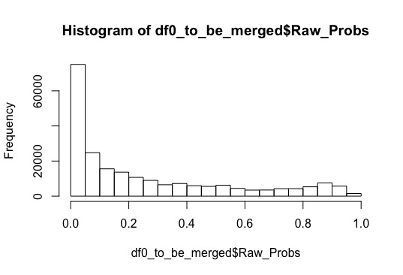
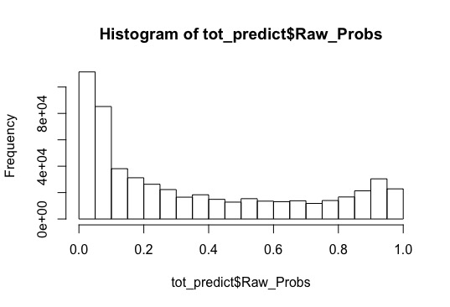
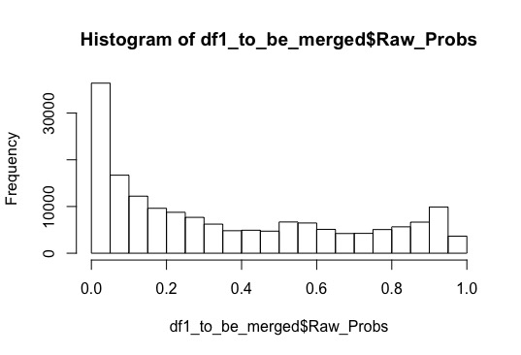
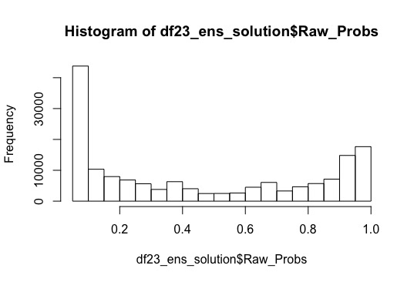
Second Try – Meta Model
- using CaretStack(), meta model - gbm
Threshold: 0.73
Threshold: 0.69
Threshold: 0.85
AMS：3.26

Slide 15
Third Try – Manually Stacking Meta Features
Accuracy of
Df0 (train) test:
0.919203 !
Apply to Test Dataset:
Break test into: test_0 | test_1 | test_23
Plug into 3 logit models
Stack results into 1 submission file
Raw Data
Subset by “PRI_jet_num”
0 1 2 & 3
Drop:
DER_deltaeta_jet_jet DER_mass_jet_jet DER_prodeta_jet_jet DER_lep_eta_centrality PRI_jet_leading_pt PRI_jet_leading_eta PRI_jet_leading_phi PRI_jet_subleading_pt PRI_jet_subleading_eta PRI_jet_subleading_phi
PRI_jet_num
PRI_jet_all_pt
DER_lep_eta_centrality DER_deltaeta_jet_jet DER_mass_jet_jet DER_prodeta_jet_jet PRI_jet_subleading_pt PRI_jet_subleading_eta PRI_jet_subleading_phi
None
Run 3 logit
tune for threshold
Meta_data0
xgb_0 | rf_0 | ada_0
Meta_data1
xgb_1 | rf_1 | ada_1
Meta_data23
xgb_23 | rf_23 | ada_23
Impute:
DER_mass_MMC
(0.26 missing)
DER_mass_MMC
(0.1 missing)
DER_mass_MMC
(0.061 missing)
For each of 3 subsets:
Apply tuned parameters
Run 3 models on train
Obtain predictions (probability) from 3 models
Cbind with Label(outcome)
Tune
XGB |RF | Ada
For df0
Tune
XGB |RF |Ada
For df1
Tune
XGB |RF |Ada
For df23

Slide 16
Further Steps
Manually stacking meta features for all 3 subsets
Tuning thresholds and train 3 logit models
Splitting real test datasets into 3 and plug into logit models
Stacking results and submit
Try meta models other than logistic regression

Slide 17

Thank you!

